Slide 1
CS5322 Database Security

Slide 2
Lecturer
Xiaokui XIAO (Cedric)
Email: xkxiao@nus.edu.sg
Office: COM1-03-25

Slide 3
Coming Next
Overview of CS5322
A short break
Discretionary Access Control

Slide 4
Course Objective
Provide an overview of database security concepts and techniques
Discuss new directions of database security

Slide 5
Background required
Databases
Relational model, SQL, etc
SELECT XXX FROM YYY WHERE ZZZ
Index structures (e.g., B-trees), query processing algorithms
Basic cryptography
Public-key cryptography
Cryptographic hash function
…
Basic probabilistic analysis
Pr[A | B] = Pr[A & B] / Pr[B]
π_{Company, Shop}
Χ
σ_{Product = ‘Toy’}
σ_{Product = ‘Toy’}
Produce
Sell
Notes:
<number>

Slide 6
References
Databases
Raghu Ramakrishnan and Johannes Gehrke: Database Management Systems.
Hector Garcia-Molina, Jeffrey D. Ullman, and Jennifer Widom: Database Systems -- The Complete Book.
A. Silberschatz, H. Korth, and S. Sudarshan: Database System Concepts
Security
Charles P. Pfleeger, Shari L. Pfleeger, and Jonathan Margulies: Security in Computing
William Stallings: Cryptography and Network Security
David C. Knox, William Maroulis, and Scott Gaetjen: Oracle Database 12c Security
Additional research papers

Slide 7
Assessment
Final exam (50 marks)
Project (50 marks)
Team-based (up to 5 students per team)
2 sub-projects + 1 research paper presentation
Research paper presentations will be in the Weeks 10-12 lectures
Notes:
<number>

Slide 8
Note
You are to form project teams by Week 4
We will send out email announcements for this
In general, please pay close attention to email announcements from this course
Otherwise, it could cause significant delays that are difficult to make up for
Anecdote:
In the previous years, there were always students who chose to ignore all emails until near the recess week

Slide 9
Why Do We Care About Database Security?
Amount of acquired data is increasing
More sensitive data being exposed
Access to data has become much easier

Slide 10
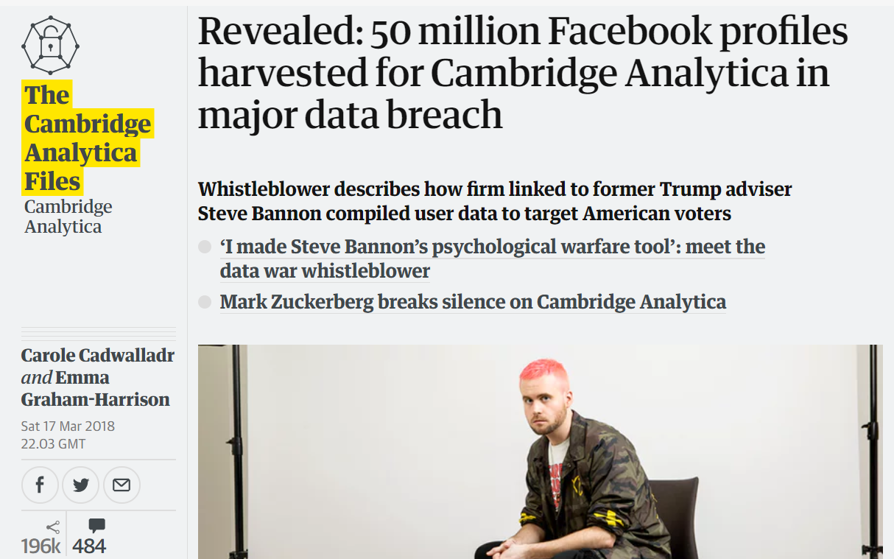

Slide 11
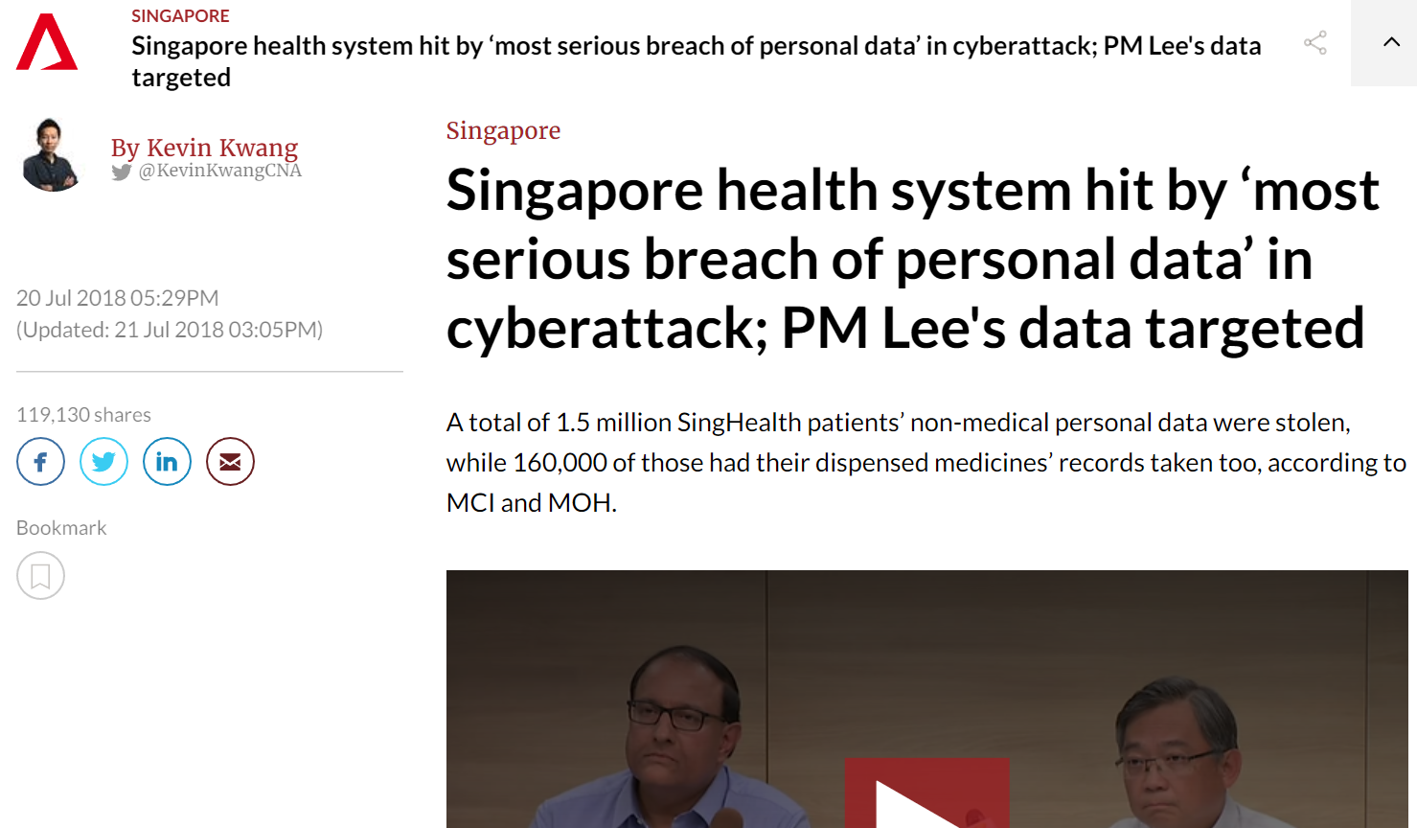

Slide 12
Why Do Attackers Attack?
Profit
Data is a valuable asset
It could even be sold (e.g., in the dark web)
Espionage
Damage
Fun

Slide 13
How Do We Secure Databases?
A lot of different techniques
Access control
Query auditing
Data sanitization
Query authentication
Encrypted database
Trusted hardware
…

Slide 14
Database Security: Main Requirements
Confidentiality
Information is disclosed only to those authorized
Integrity
Maintaining data validity against malicious or accidental modifications
Availability
Maintaining the data/resource/service deliverable to authorized users

Slide 15
Database Security: Additional Requirements
Accountability
Hold a subject responsible for his/her actions
Example
If a database entry is maliciously modified, there should be a way to trace back to the culprit
If a database entry is leaked, there should be a way to identify a list of persons who have accessed the entry
Useful for honeypot as well

Slide 16
Database Security: Additional Requirements
Privacy
Maintaining confidentially of sensitive personal information
Can be regarded as a special type of confidentiality
Example
A hospital shares data with medical researchers
The shared data should be useful for a medical study, but should not reveal the identities of the patients
i.e., it is about how we can reveal useful data without disclosing sensitive personal information

Slide 17
How Do We Secure Databases?
We will talk about how the above requirements can be satisfied using
Access control
Query auditing
Data sanitization
Query authentication
Encrypted database
Trusted hardware
…
But in general, there is no silver bullet for database security

Slide 18
Example: Inference Attacks
Name | Gender | Program | Grade
Alice | F | CS | 80
Bob | M | CS | 90
Cathy | F | IS | 90
Daisy | F | IS | 100
Eric | M | CS | 90
Fred | M | CS | 90
Suppose that we are have the above table T about CS5322 grades
Requirements:
Users are not allowed to inquire about any individual student’s grade

Slide 19
Example: Inference Attacks
Name | Gender | Program | Grade
Alice | F | CS | 80
Bob | M | CS | 90
Cathy | F | IS | 90
Daisy | F | IS | 100
Eric | M | CS | 90
Fred | M | CS | 90
A user issues three queries:
SELECT COUNT(*), AVG(Grade) FROM T WHERE Gender = ‘F’
SELECT COUNT(*), AVG(Grade) FROM T WHERE Program = ‘CS’
SELECT COUNT(*), AVG(Grade) FROM T

Slide 20
Course Objective
Provide an overview of database security concepts and techniques
Discuss new directions of database security
Mostly introductory stuff, with a focus in the database context

